Slide 1

Digital Signal Processors and Architecture
Dr Noor Mahammad Sk

Slide 2
High Performance Circuit Design
High speed Adder Circuits
Carry Ripple – Inherently Sequential
Carry Look ahead – Parallel version
You should understand the conversion portion
Multipliers
Wallace-tree multipliers

Slide 3
High Performance Circuit Design
Performance of a circuit
Circuit depth – maximum level in the topological sort.
Circuit Size – Number of combinational elements.
Optimize both for high performance.
Both are inversely proportional – so a balance to be arrived.

Slide 4
Carry Ripple Adder
Given two n-bit numbers
(a(n-1), a(n-2), a(n-3), …, a(0)) and
(b(n-1), b(n-2), b(n-3) ,…, b(0)).
A full adder adds three bits (a, b, c), where ‘a’ and ‘b’ are data inputs and ‘c’ is the carry-in bit.
It outputs a sum bit ‘s’ and a carry-out bit ‘co’

Slide 5
Full Adder
a
b
Full Adder
a
co
c
b
c
a
b
s
c

Slide 6
n-bit Carry Ripple Adder
Circuit Depth is ‘n’.
Circuit area is ‘n’ times size of a Full Adder
B(n-1)
A(n-1)
B(2)
A(2)
B(1)
A(1)
B(0)
A(0)
FA(n-1)
C(n-2)
FA(2)
FA(1)
FA(0)
C(0)
C(n)
S(n-1)
C(3)
C(2)
S(1)
C(1)
S(2)
S(0)

Slide 7
Carry Lookahead Adder
The depth is ‘n’ because of the carry.
Some interesting facts about carry
a(j) | b(j) | c(j) | c(j+1)
0 | 0 | 0 | 0
0 | 0 | 1 | 0
0 | 1 | 0 | 0
0 | 1 | 1 | 1
1 | 0 | 0 | 0
1 | 0 | 1 | 1
1 | 1 | 0 | 1
1 | 1 | 1 | 1
If a(j) = b(j) then
c(j+1) = a(j) = b(j)
If a(j) <> b(j) then
c(j+1) = c(j)

Slide 8
Carry Lookahead Circuit
a(j) | b(j) | c(j+1) | Status x(j+1)
0 | 0 | 0 | Kill (k)
0 | 0 | 1
0 | 1 | c(j) = 0 | Propagate (p)
0 | 1 | c(j) = 1
1 | 0 | c(j) = 0 | Propagate (p)
1 | 0 | c(j) = 1
1 | 1 | 0 | Generate (g)
1 | 1 | 1

Slide 9
Carry Lookahead Circuit
x(j+1)
(*) | k | p | g
k | k | k | g
p | k | p | g
g | k | g | g
New (j+1)th carry status as influenced by x(j)
(*) is associative
x(j)
y(j) = x(0) (*) x(1) (*) … x(j)
x(0) = k
If y(j) = k then c(j) = 0
If y(j) = g then c(j) = 1
Note that y(j) <> p

Slide 10
Carry Calculations
A prefix computation
y(0) = x(0) = k
y(1) = x(0) (*) x(1)
y(2) = x(0) (*) x(1) (*) x(2)
…….
y(n) = x(0) (*) x(1) (*) …. x(n)
Let [i,j] = x(i) (*) x(i+1) (*) … x(j)
[i,j] (*) [j+1,k] = [i,k]
By associative property

Slide 11
Parallel Prefix Circuit
Input x(0), x(1), … x(n) – for an n-bit CLA, where x(0) = k.
Each x(i) is a 2-bit vector
To compute the prefix (*) and pipeline the same.
y(i) = x(0) (*) x(1) (*) … x(i)
We can use the Recursive Doubling Technique described as follows

Slide 12
An 8-node Carry Lookahead Adder
Parallel Prefix Circuit
y₈
x₈
y₇
x₇
y₆
x₆
y₅
x₅
y₄
x₄
y₃
x₃
y₂
x₂
y₁
x₁
y₀
x₀
g
p
g
g
k
k
g
g
g
p
g
g
k
p
k
p
k
k
KGP₇
KGP₇
KGP₆
KGP₅
KGP₄
KGP₃
KGP₂
KGP₁
KGP₀
k
0
0
0
1
1
1
0
0
1
1
1
0
1
1
1
0
0
1
0
a₈
b₈
a₇
b₇
a₆
b₆
a₅
b₅
a₄
b₄
a₃
b₃
a₂
b₂
a₁
b₁
a₀
b₀
1
0
0
1
1
0
0
1
1
s₀
s₀
s₀
s₀
s₀
s₀
s₀
s₀
s₀

Slide 13
Parallel Techniques: Recursive Doubling
Finding Prefix sum of ‘8’ numbers
-15
6
-8
7
3
-2
1
0
7
6
5
4
3
2
1
0

Slide 14
Recursive Doubling (Step 1)
Finding Prefix sum of ‘8’ numbers
-9
-2
-1
10
1
-1
1
0
STEP 1

Slide 15
Recursive Doubling (Step 2)
-10
8
0
9
2
-1
1
0
STEP 2

Slide 16
Recursive Doubling (Step 3)
-8
7
1
9
2
-1
1
0
STEP 3

Slide 17
Prefix Sum of n numbers in log n steps
Recursive Doubling is applicable:
Operators like Min, Max, Mul etc. that is associative

Slide 18
Prefix Calculation Based on Recursive Doubling Technique
g
k
g
p
g
p
p
k
g
k
g
g
g
p
k
k
g
k
g
g
g
k
k
k
g
k
g
g
g
k
k
k

Slide 19
Pipeline Prefix Calculation Based on Recursive Doubling Technique
g
k
g
p
g
p
p
k
g
k
g
g
g
p
k
k
g
k
g
g
g
k
k
k
g
k
g
g
g
k
k
k

Slide 20
Outcome of Above Method
Depth of the circuit reduced from O(n) to O(log₂ n)
Size is still O(n)
This results in a Fast Adder

Slide 21
Addition & Subtraction Signed Numbers
Operation | Add Magnitudes | Subtract Magnitudes
 |  | A > B | A < B | A = B
( + A ) + ( + B ) | + ( A + B )
( + A ) + ( - B ) |  | + ( A – B ) | - ( B – A ) | + ( A – B )
( - A ) + ( + B ) |  | - ( A – B ) | + ( B – A ) | + ( A – B )
( - A ) + ( - B ) | - ( A + B )
( + A ) - ( + B ) |  | + ( A – B ) | - ( B – A ) | + ( A – B )
( + A ) - ( - B ) | + ( A + B )
( - A ) - ( + B ) | - ( A + B )
( - A ) - ( - B ) |  | - ( A – B ) | + ( B – A ) | + ( A – B )

Slide 22
Hardware for Signed Magnitude Addition & Subtraction
B_{s}
B Register
M (Mode Control)
AVF
Complementer
Output carry
E
Parallel Adder
Input Carry
S
A_{s}
A Register
Load sum
A_{s} – sign of A
B_{s} – sign of B
A_{s} & A – Accumulator
AVF – overflow bit for A+B
E – Output carry for parallel adder
Mode = 0: S = A + B, input carry = 0
Mode = 1: S = A + B’ + 1, Input carry = 1

Slide 23
Flowchart for add & subtract operations
Subtract operation
Add operation
Minuend in A
Subtrahend in B
Augend in A
Addend in B
= 0
= 1
= 1
= 0
A_{s} xor B_{s}
A_{s} xor B_{s}
A_{s} = B_{s}
A_{s} = B_{s}
A_{s} ≠ B_{s}
A_{s} ≠ B_{s}
EA ← A+B’ +1
AVF ← 0
EA ← A+B
= 0
E
= 1
A >= B
A < B
AVF ← E
≠ 0
A
= 0
A ← A’
A_{s} ← 0
A ← A + 1
A_{s} ← A_{s}’
END
(result in A and A_{s})

Slide 24
Multipliers
Simple grade-school multiplication method.
Concept of partial-products
Partial products generated in parallel and carry save addition results in faster array multiplier

Slide 25
Grade School Multiplication
1 1 1 0 = a
1 1 0 1 = b
------------------------------
1 1 1 0 = m(0)
0 0 0 0 = m(1)
1 1 1 0 = m(2)
1 1 1 0 = m(3)
-------------------------------
1 0 1 1 0 1 1 0 = p

Slide 26
Hardware for multiply operation
B_{s}
B Register
Sequence Counter (SC)
Complementer and
Parallel Adder
(rightmost bit)
Q_{n}
A_{s}
Q_{s}
0
E
A Register
Q register

Slide 27
Description
Q – Multiplier
B – Multiplicand
A – 0
SC – number of bits in multiplier
E – overflow bit for A
Do SC times
If low-order bit of Q is 1
A ← A + B
Shift right EAQ
Product is in AQ

Slide 28
Flowchart
Multiplier Operation
Multiplicand in B
Multiplier in Q
A_{s} ← Q_{s} xor B_{s}
Q_{s} ← Q_{s} xor B_{s}
A ← 0, E ← 0
SC ← n
= 0
Q_{n}
= 1
EA ← A + B
Shr EAQ
SC ← SC – 1
≠ 0
SC
= 0
END (product is in AQ)

Slide 29
Example: 23x19 = 437
Multiplicand B= 10111 | E | A | Q | SC
Multiplier in Q Q_{n} = 1; add B | 0 | 00000 10111 | 10011 | 101
First partial Product Shift right EAQ Q_{n} = 1; add B | 0 0 | 10111 01011 10111 | 10011 11001 | 100
Second Partial Product Shift right EAQ Q_{n} = 0; shift right EAQ Q_{n} = 0; shift right EAQ Q_{n} = 1; add B | 1 0 0 0 | 00010 10001 01000 00100 10111 | 11001 01100 10110 01011 | 011 010 001
Fifth partial product Shift right EAQ | 0 0 | 11011 01101 | 10101 | 000
Final Product in AQ = |  | 01101 10101

Slide 30
Multiply Signed Numbers
Booth Algorithm
QR – Multiplier
Q_{n} – least significant bit of QR
Q_{n+1} – previous least significant bit of QR
BR – Multiplicand
AC – 0
SC – number of bits in multiplier

Slide 31
Booth Algorithm
Do SC + 1 times
Q_{n}Q_{n+1} = 10
AC ← AC + BR’ + 1
Q_{n}Q_{n+1} = 01
AC ← AC + BR
Arithmetic shift right AC & QR
SC ← SC – 1

Slide 32
Hardware for Booth Algorithm
BR register
Sequence Counter (SC)
Complementer and
Parallel adder
Q_{n}
Q_{n+1}
AC register
QR register

Slide 33
Flowchart
Multiply
Multiplicand in BR
Multiplier in QR
Booth algorithm for
Multiplication of signed-2’s complement numbers
AC ← 0
Q_{n+1} ← 0
SC ← n
= 10
Q_{n} Q_{n+1}
= 01
AC ← AC + BR’ + 1
= 00
= 11
AC ← AC + BR
ashr (AC & QR)
SC ← SC – 1
≠ 0
= 0
SC
END

Slide 34
Example: -9 x -13 = 117
Q_{n} Q_{n+1} | BR = 10111 BR’ + 1= 01001 | AC | QR | Q_{n+1} | SC
1 0 | Initial Subtract BR | 00000 01001 | 10011 | 0 | 101
1 1 0 1 | ashr ashr Add BR | 01001 00100 00010 10111 | 11001 01100 | 1 1 | 100 011
0 0 1 0 | ashr ashr Subtract BR | 11001 11100 11110 01001 | 10110 01011 | 0 0 | 010 001
 | ashr | 00111 00011 | 10101 | 1 | 000

Slide 35
Array Multiplier
Combination circuit
Product generated in one micro-operation
Requires large number of gates
Became feasible after integrated circuits developed
Needed for ‘j’ multiplier and ‘k’ multiplicand bits
j x k – AND gates
j – 1 k-bit adders to produce product of j +k bits

Slide 36
2-bit by 2-bit Array Multiplier
b₁ b₀
a₁ a₀
a₀b₁ a₀b₀
a₁b₁ a₁b₀
c₃ c₂ c₁ c₀
a₀
b₀
b₁
a₁
b₁
b₀
HA
A B
HA
A B
C S
C S
C₃
C₂
C₁
C₀

Slide 37
4–bit by 3-bit array multiplier
a₀
b₃
b₂
b₁
b₀
a₁
b₃
b₂
b₁
b₀
0
Addend
Augend
4 – bit adder
Sum and output carry
a₂
b₃
b₂
b₁
b₀
Addend
4 – bit adder
Augend
Sum and output carry
c₆
c₅
c₄
c₃
c₂
c₁
c₀

Slide 38
Carry Save Addition
Given three n-bit numbers x, y and z.
The circuit computes a n-bit number ‘u’ and a (n+1)-bit number ‘v’ such that
x+y+z = u + v

Slide 39
Carry Save Addition Example
8
7
6
5
4
3
2
1
0
i
0
0
0
1
1
1
0
1
=
x
1
1
0
0
0
1
0
1
=
y
1
0
0
1
0
1
1
0
=
z
0
1
0
0
1
1
1
0
=
u
1
0
0
1
0
1
0
1
0
=
v

Slide 40
Carry Save Adder Circuit
v₈
u₇
v₇
u₆
v₆
u₅
v₅
u₄
v₄
u₃
v₃
u₂
v₂
u₁
v₁
u₀
v₀
1
0
0
1
0
1
0
1
0
0
1
0
0
1
1
1
0
FA₇
FA₆
FA₅
FA₄
FA₃
FA₂
FA₁
FA₀
1
1
0
0
1
0
0
0
0
1
0
1
0
0
1
1
1
1
1
0
0
0
1
1
z₇
y₇
x₇
z₆
y₆
x₆
z₅
y₅
x₅
z₄
y₄
x₄
z₃
y₃
x₃
z₂
y₂
x₂
z₁
y₁
x₁
z₀
y₀
x₀
0

Slide 41
Carry Save Addition based Multiplication
 |  |  |  | 0 | 0 | 0 | 0 | = | 0
 |  |  |  | 1 | 1 | 1 | 0 | = | m(0)
 |  |  | 0 | 0 | 0 | 0 |  | = | m(1)
 |  |  | 0 | 1 | 1 | 1 | 0 | = | u(1)
 |  |  | 0 | 0 | 0 |  |  | = | v(1)
 |  | 1 | 1 | 1 | 0 |  |  | = | m(2)
 |  | 1 | 1 | 0 | 1 | 1 | 0 | = | u(2)
 |  | 0 | 1 | 0 |  |  |  |  | v(2)
 | 1 | 1 | 1 | 0 |  |  |  | = | m(3)
 | 1 | 0 | 1 | 0 | 1 | 1 | 0 | = | u(3)
 | 1 | 1 | 0 |  |  |  |  | = | v(3)
1 | 0 | 1 | 1 | 0 | 1 | 1 | 0 | = | p

Slide 42
Wallace Tree Multipliers
While multiplying two n-bit numbers a total of n partial products have to be added.
Use floor(n/3) carry save adders and reduce the number to ceil(2n/3).
Apply it recursively.
O(log n) depth circuit of size O(n²).

Slide 43
8-bit Wallace Tree Multiplication
m(0)
m(1)
m(2)
m(3)
m(4)
m(5)
8
9
10
11
12
13
Carry Save Adder
Carry Save Adder
m(6)
m(7)
10
10
13
13
14
15
Carry Save Adder
Carry Save Adder
13
15
13
15
Carry Save Adder
15
15
Carry Save Adder
15
16
Carry Lookahead Adder
16
P

Slide 44
Floating Point Arithmetic
Dr Noor Mahammad Sk

Slide 45
Floating Point Numbers
B = b₀ . b₋₁ b₋₂ … b_{-(n-1)}
F(B) = -b₀ x 2⁰ + b₋₁ x 2⁻¹ + b₋₂ x 2⁻² + … + b_{-(n-1)} x 2^{-(n-1)}
IEEE Standards for floating point numbers
± X₁ . X₂ X₃ X₄ X₅ X₆ X₇ x 10 ^{±Y1Y2}
Single Precision (32 – bits)
Value represented = ± 1. M x 2^{E’ – 127} (E’ = E + 127)
Where E stands for Exponent
Double Precision (64 – bits)
Value represented = ± 1. M x 2^{E’ – 1023} (E’ = E + 1023)

Slide 46
Single Precision
Not Normalized
0.0010110 … x 2⁹
Normalized
1.0110 … x 2⁶
32 bits
S
E’
M
Sign of
Number
0 signifies +
1 signifies -
8-bit signed
Exponent in
Excess – 127
representation
23 bits Mantissa fraction
Value represented = ± 1. M x 2^{E’ – 127} (E’ = E + 127)

Slide 47
Double Precision
Single Precision
1 ≤ E’ ≤ 254 (-126 ≤ E ≤ 127)
Double Precision
1 ≤ E’ ≤ 2046 (-1022 ≤ E ≤ 1023)
64 bits
S
E’
M
Sign of
Number
0 signifies +
1 signifies -
11-bit signed
Exponent in
Excess – 1023
representation
52 bits Mantissa fraction
Value represented = ± 1. M x 2^{E’ – 1023} (E’ = E + 1023)

Slide 48
Example
0
0 0 1 0 1 0 0 0
0 0 1 0 1 0 . . . 0
Value represented = + 1.0010110 …0 x 2⁻⁸⁷
0
1 0 0 0 0 1 0 1
0 1 1 0 . . .
Value represented = + 1.0110 … x 2⁶

Slide 49
IEEE 754 Format Interpretation
 |  |  | Single Precision |  | Double Precision
 | Sign | Fraction | Biased Exponent | Value | Biased Exponent | Value
Positive Zero | 0 | 0 | 0 | 0 | 0 | 0
Negative Zero | 1 | 0 | 0 | 0 | 0 | 0
Plus Infinity | 0 | 0 | 255 (all 1’s) | +∞ | 2047 (all 1’s) | +∞
Minus Infinity | 1 | 0 | 255 (all 1’s) | -∞ | 2047 (all 1’s) | -∞
Not a Number | 0 or 1 | ≠0 | 255 (all 1’s) | NaN | 2047 (all 1’s) | NaN
Positive normalized nonzero | 0 | M | 0 <E’<255 | 2^{E’-127} (1.M) | 0 <E’<2047 | 2^{E’-1023} (1.M)
Negative normalized nonzero | 1 | M | 0 <E’<255 | -2^{E’-127} (1.M) | 0 <E’<2047 | -2^{E’-1023} (1.M)
Positive denormalized | 0 | M ≠ 0 | 0 | -2^{E’-127} (0.M) | 0 | -2^{E’-1023} (0.M)
Negative denormalized | 1 | M ≠ 0 | 0 | -2^{E’-127} (0.M) | 0 | -2^{E’-1023} (0.M)

Slide 50
Floating Point Registers
B_{s}
B
b
BR
E
Parallel Adder
Parallel Adder
And Comparator
A_{s}
A
A₁
a
AC
Q_{s}
Q
q
QR
Sign
Mantissa
Exponent

Slide 51
Floating Point Add/ Subtract
Check for zeros
Align the mantissa
Add or subtract mantissas
Normalize the result

Slide 52
Flowchart
Add or Subtract
=0
BR
≠0
AC
≠0
=0
a < b
a:b
a > b
AC ← BR
Align mantissas
Shr A
a ← a + 1
Shr B
b ← b +1
Check for zeros
add
op
Sub
add
op
Sub
=0
A_{s} xor B_{s}
=1
=1
A_{s} xor B_{s}
=0
A_{s} ← A’_{s}
Add or sub mantissas
EA ← A + B’ + 1
EA ← A + B
A ← A’+1
A_{s} ← A’_{s}
=0
=0
E
E
=1
≠0
=0
=1
A
Shr A
A₁ ← E
a ← a + 1
Shl A
a ← a – 1
=0
A₁
=1
AC ← 0
Normalization
END

Slide 53
Multiplication
Check for zeros
Add the exponents
Multiply the mantissas
Normalize the product

Slide 54
Flowchart
= 0
Multiplicand in BR
Multiplier in QR
BR
Multiply
≠ 0
= 0
QR
≠ 0
AC ← 0
a ← q
a ← a + b
a ← a - bias
Multiply Mantissa
Using Multiply Algorithm
Shl AQ
a ← a - 1
= 0
A₁
= 1
END (product is AC)

Slide 55
Floating Point Division
Check for zeros
Initialize registers and evaluate the sign
Align the dividend
Subtract the exponents
Divide the mantissas

Slide 56
Flow Chart
= 0
Divisor in BR
Dividend in AC
BR
≠ 0
Divide by
zero
= 0
AC
≠ 0
END
(Quotient is in QR)
QR ← 0
Q_{s} ← A_{s} xor B_{s}
Q ← 0; SC ← n
EA ← A + B’ + 1
Divide magnitude of
mantissas using
division algorithm
END
(Quotient is in QR)
= 1
= 0
E
A >= B
A < B
A ← A + B
A ← A + B
q ← a
Shr A
a ← a + 1
a ← a + bias
a ← a + b’ + 1

Slide 57
Implementation of Elementary Functions

Slide 58
Elementary Functions of Signal Processing
In addition to the basic operations – Addition, Subtraction, Multiplication and Division
Elementary Signal Processing Functions
Trigonometric Functions
Functions as
Square root,
Logarithm and
Exponentiation
General Methods for computation of elementary functions are explained here
CORDIC architectures are used for implementation of elementary signal processing functions

Slide 59
Elementary Functions of Signal Processing
Methods for computing elementary functions
Table oriented methods
Polynomial Approximation
Iterative Methods
CORDIC Algorithm

Slide 60
Table Oriented Method
All functions are implemented using tables
The function values are stored directly in memory
The function argument addresses a memory location
And content yields the function value
Disadvantage of this method is the exponential growth in the memory requirements
This method is only economical for small word widths

Slide 61
Table Oriented Method
Given n-bit function argument and m-bit function value representation
The direct storage in a table would require N_{sp} = m 2^{n} storage locations
Typical memory structures for permanent storage are
ROM (read only memory)
PLAs (programmable logic arrays)

Slide 62
Table Oriented Method
2n
m
AND Plane
OR Plane
k
Scheme of representation of permanent memory
Buffer
Buffer
n
m
In
Out
Each logic function can be implemented as a two-stage sum-of-products (AND/OR) or a two stage product-of-sum (OR/AND)
If working with minterms, the minterms are created by ANDing all variables
The actual functions results from OR of the minterms

Slide 63
Table Oriented Method
In ROM, all 2^{n} minterms (k=2^{n}) are evaluated in the AND stage
The AND stage acts as a decoder for a given input
One of the 2^{n} decoder output line will be 1
All others will be 0
When ever several functions are to be implemented as tables, the memory requirement grow accordingly.

Slide 64

Polynomial Approximation
An alternative to table oriented method
A function f(x) is approximated by a polynomial P_{n}(x) of degree n,
whereby the approximation error within the defining interval should be smaller than the given tolerance value
Polynomial coefficients are usually calculated by truncating an infinite power series

Slide 65
CORDIC ALGORITHM

Slide 66
CORDIC Algorithm COordinate Rotation DIgital Computer
Method for Elementary Function Evaluation (e.g., sin(z), cos(z), tan⁻¹(y))
Originally Used for Real-time Navigation (Volder 1956)
Idea is to Rotate a Vector in Cartesion Plane by Some Angle
Complexity Comparable to Division

Slide 67
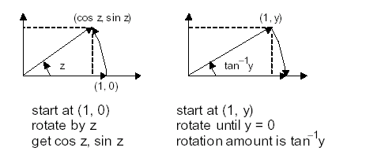
CORDIC Algorithm Key Ideas
If we have a computationally efficient way of rotating a vector, we can evaluate cos, sin, and tan–1 functions
Rotation by an arbitrary angle is difficult, so we perform psuedo rotations
Use special angles to synthesize a desired angle z
z = α⁽¹⁾ + α⁽²⁾ + . . . + α^{(m)}

Slide 68
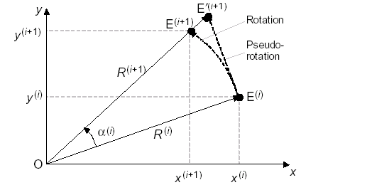
CORDIC Algorithm Key Ideas
Rotate the vector OE ^{(i)} with end point at (x ^{(i)}, y ^{(i)}) by α ^{(i)}
x ^{(i+1)} = x ^{(i)}cos α ^{(i)}– y ^{(i)} sin α ^{(i)} = (x ^{(i)} – y ^{(i)} tan α ^{(i)})/(1 + tan²α ^{(i)})^{1/2}
y ^{(i+1)} = y ^{(i)} cos α ^{(i)} + x ^{(i)} sin α ^{(i)} = (y ^{(i)} + x ^{(i)} tan α ^{(i)})/(1 + tan²α ^{(i)} ) ^{1/2}
z ^{(i+1)} = z ^{(i)} – α ^{(i)}
Goal: eliminate the divisions by (1 + tan2α ^{(i)}) ^{1/2} and choose α ^{(i)} so that tan α^{(i)} is a power of 2

Slide 69
Elimination of Division by (1 + tan2α^{(i)})^{1/2}
Whereas a real rotation does not change the length R(i) of
the vector, a pseudorotation step increases its length to:
R^{(i+1)} = R^{(i)} (1 + tan²α ^{(i)})^{1/2}
The coordinates of the new end point E′^{(I+1)} after
pseudorotation is derived by multiplying the coordinates of
E^{(i+1)} by the expansion factor
x ^{(i+1)} = x ^{(i)} – y ^{(i)} tan α ^{(i)}
y ^{(i+1)} = y ^{(i)} + x ^{(i)} tan α ^{(i)} [Pseudorotation]
z ^{(i+1)} = z ^{(i)} – α ^{(i)}

Slide 70
Elimination of Division by (1 + tan2α^{(i)})^{1/2}
Assuming x⁽⁰⁾ = x, y ⁽⁰⁾ = y, and z ⁽⁰⁾ = z, after m real
rotations by the angles α⁽¹⁾, α ⁽²⁾, . . . , α ^{(m)}, we have:
x^{(m)} = x cos(∑α ^{(i)})– y sin(∑α ^{(i)})
y^{(m)} = y cos(∑α ^{(i)}) + x sin(∑α ^{(i)})
z^{(m)} = z – (∑α ^{(i)})
After m pseudo rotations by the angles α⁽¹⁾, α ⁽²⁾, . . . , α ^{(m)}:
x^{(m)} = K(x cos(∑α ^{(i)})– y sin(∑α ^{(i)}))
y^{(m)} = K(y cos(∑α ^{(i)}) + x sin(∑α ^{(i)})) [*]
z^{(m)} = z – (∑α ^{(i)})
where K = Π(1 + tan²α^{(i)})^{1/2}

Slide 71
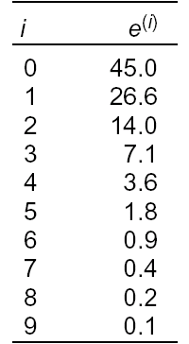
Basic CORDIC Iterations
Pick α ^{(i)} such that tan α ^{(i)} = d_{i} 2 ^{–i}, d_{i} ∈ {–1, 1}
x^{(i+1)} = x^{(i)} – d_{i} y(i)2^{–i}
y ^{(i+1)} = y ^{(i)} + d_{i} x(i)2^{–i}[CORDIC iteration]
z ^{(i+1)} = z ^{(i)} – d_{i} tan^{–1} 2^{–i}
If we always pseudo rotate by the same set of angles (with
+ or – signs), then the expansion factor K is a constant
that can be pre computed
Example: pseudo rotation for 30 degrees
30.0 ≅ 45.0 – 26.6 + 14.0 – 7.1 + 3.6 + 1.8 – 0.9
+ 0.4 – 0.2 + 0.1 = 30.1
e ^{(i)} = tan ^{–1} 2^{-i}

Slide 72
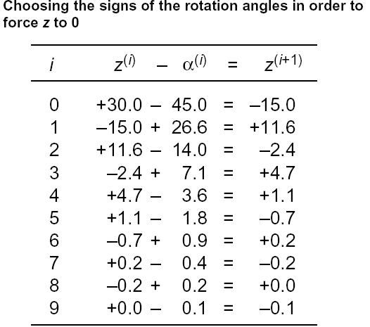
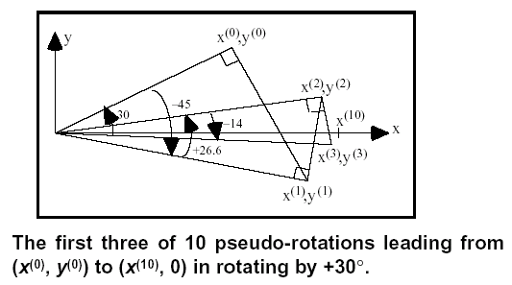
Basic CORDIC Iteration

Slide 73
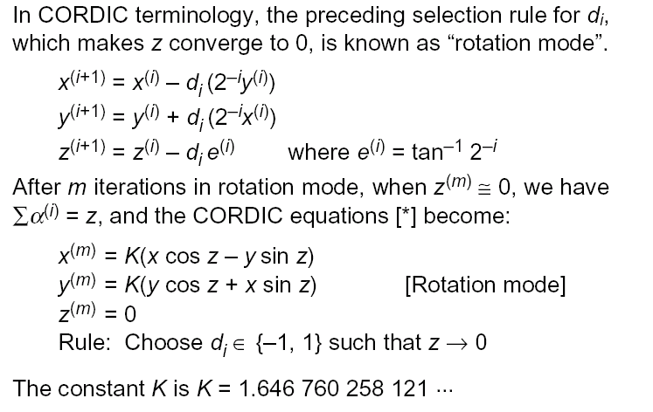
CORDIC Rotation Mode

Slide 74
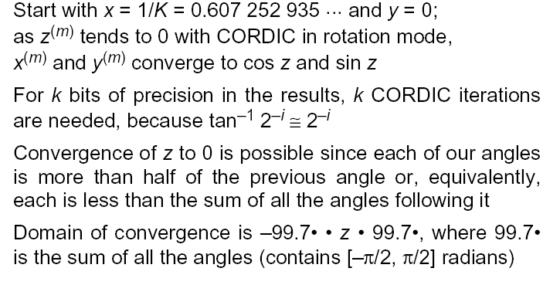
CORDIC Rotation Mode

Slide 75
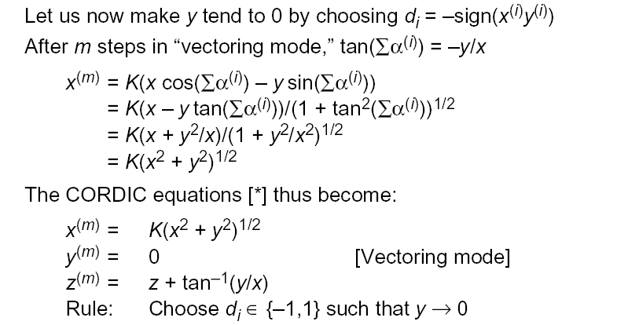
CORDIC Vectoring Mode

Slide 76
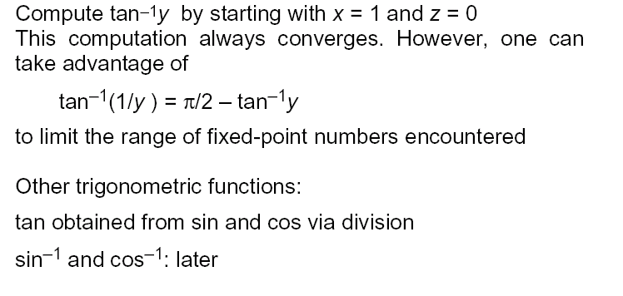
CORDIC Vectoring Mode

Slide 77
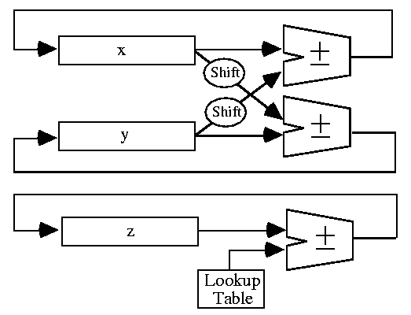
CORDIC Hardware

Slide 78
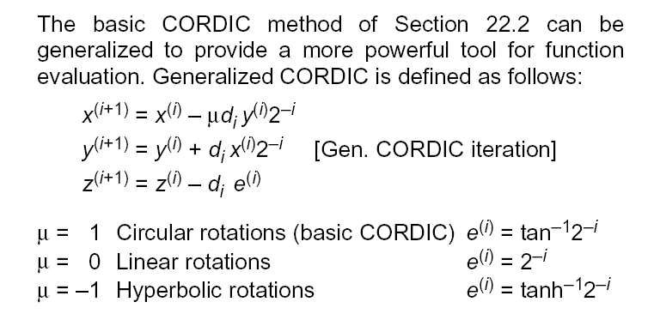
Generalized CORDIC

Slide 79
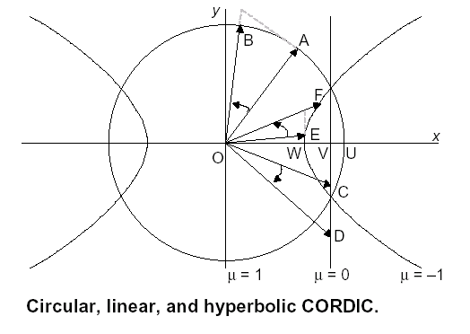
Rotation Modes

Slide 80
Binary Angular Measurement - BAM
Angle Accumulator can Represent Angles as BAM
Encode d_{i}={-1,+1} as Bit Values {0,1}
Example: -1 Represented by 0 and +1 Represented by 1
LSb Represents d₀
Content z=01011
z=+45 ° +26.6 ° -14.0 ° +7.1 ° -3.6 ° =61.1°
Can Simplify CORDIC Circuitry for Some Modes
May Need BAM encode/decode – Can Use Lookup Table

Slide 81
Review - CORDIC - Rotation Mode
Input is Angle, α – Initialized in Angle Accumulator
Vector Initialized to Lie on x-axis
Each Iteration d_{i} Chosen by Sign of Angle
Attempt to Bring Angle to Zero
Result is x Register Contains ~cosα
Result is y Register Contains ~sinα
Also Polar to Rectangular if x Register Initialized to Magnitude

Slide 82
Review - CORDIC - Vector Mode
Input is (Pre-scaled) Vector in (x,y) Registers
Angle, α – Initialized to Zero
Each Iteration d_{i} Chosen to Move Vector to Lie Along Positive x-axis (Want to Reduce y Register to Zero)
Result is Original Vector Angle in Angle Accumulator
Can be Used for sin⁻¹α and cos⁻¹α
Also Rectangular to Polar Conversion
Magnitude in x Register

Slide 83
CORDIC – Rotation/Vector Modes
Rotation Mode:
Vector Mode:

Slide 84
Rotation Angle Limits
Rotation/Vector Algorithms Limited to ±90°
Due to Use of α = tan(2⁰) for First Iteration
Several Ways to Extend Range
Can use trig identities to covert the problem to one that is within the domain of convergence
One Way is to Use Additional Rotation for Angles Outside Range
This Rotation is Initial ±90° Rotation

Slide 85
CORDIC Uses
Can Use CORDIC For Others Also:
Linear Functions
Hyperbolic Functions
Square Rooting
Logarithms, Exponentials

Slide 86
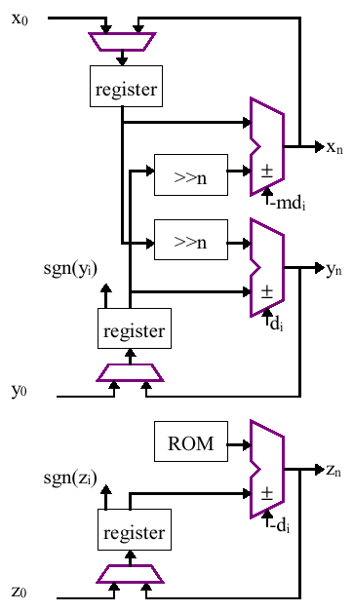
Iterative CORDIC Structure*
*Taken from “A Survey of CORDIC Algorithms for FPGA
Based Computers”, R. Andraka, FPGA’98

Slide 87
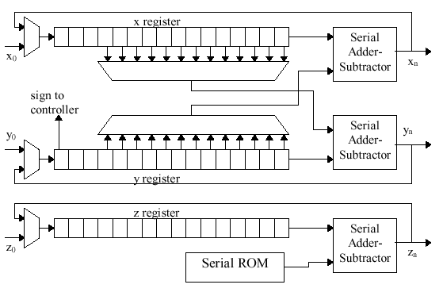
Bit-serial CORDIC Structure*
*Taken from “A Survey of CORDIC Algorithms for FPGA
Based Computers”, R. Andraka, FPGA’98

